Slide 1
Chapter 21 – Collections
Outline
21.1 Introduction
21.2 Collections Overview
21.3 Class Arrays
21.4 Interface Collection and Class Collections
21.5 Lists
21.6 Algorithms
21.6.1 Algorithm sort
21.6.2 Algorithm shuffle
21.6.3 Algorithms reverse, fill, copy, max and min
21.6.4 Algorithm binarySearch
21.7 Sets
21.8 Maps
21.9 Synchronization Wrappers
21.10 Unmodifiable Wrappers
21.11 Abstract Implementations
21.12 (Optional) Discovering Design Patterns: Design Patterns Used in Package java.util

Slide 2
21.1 Introduction
Java collections framework
  Provides reusable componentry
  Existing data structures
    Example of code reuse

Slide 3
21.2 Collections Overview
Collection
  Data structure (object) that can hold other objects
Collections framework
  Interfaces that define operations for various collection types
  Belong to package java.util
    Collection
    Set
    List
    Map

Slide 4
21.3 Class Arrays
Class Arrays
  Provides static methods for manipulating arrays
  Provides “high-level” methods
    Method binarySearch for searching sorted arrays
    Method equals for comparing arrays
    Method fill for placing values into arrays
    Method sort for sorting arrays

Slide 5
Fig. 21.1 Using methods of class Arrays.
Line 18
Line 20
Lines 22-23
1 // Fig. 21.1: UsingArrays.java
2 // Using Java arrays.
3
4 // Java core packages
5 import java.util.*;
6
7 public class UsingArrays {
8 private int intValues[] = { 1, 2, 3, 4, 5, 6 };
9 private double doubleValues[] = { 8.4, 9.3, 0.2, 7.9, 3.4 };
10 private int filledInt[], intValuesCopy[];
11
12 // initialize arrays
13 public UsingArrays()
14 {
15 filledInt = new int[ 10 ];
16 intValuesCopy = new int[ intValues.length ];
17
18 Arrays.fill( filledInt, 7 ); // fill with 7s
19
20 Arrays.sort( doubleValues ); // sort doubleValues
21
22 System.arraycopy( intValues, 0, intValuesCopy,
23 0, intValues.length );
24 }
25
26 // output values in each array
27 public void printArrays()
28 {
29 System.out.print( "doubleValues: " );
30
31 for ( int count = 0; count < doubleValues.length; count++ )
32 System.out.print( doubleValues[ count ] + " " );
33
34 System.out.print( "\nintValues: " );
35
Use static method fill of class Arrays to populate array with 7s
Use static method sort of class Arrays to sort array’s elements in ascending order
Use static method arraycopy of class System to copy array intValues into array intValuesCopy

Slide 6
Fig. 21.1 Using methods of class Arrays. (Part 2)
Line 55
Lines 61 and 66
36 for ( int count = 0; count < intValues.length; count++ )
37 System.out.print( intValues[ count ] + " " );
38
39 System.out.print( "\nfilledInt: " );
40
41 for ( int count = 0; count < filledInt.length; count++ )
42 System.out.print( filledInt[ count ] + " " );
43
44 System.out.print( "\nintValuesCopy: " );
45
46 for ( int count = 0; count < intValuesCopy.length; count++ )
47 System.out.print( intValuesCopy[ count ] + " " );
48
49 System.out.println();
50 }
51
52 // find value in array intValues
53 public int searchForInt( int value )
54 {
55 return Arrays.binarySearch( intValues, value );
56 }
57
58 // compare array contents
59 public void printEquality()
60 {
61 boolean b = Arrays.equals( intValues, intValuesCopy );
62
63 System.out.println( "intValues " + ( b ? "==" : "!=" )
64 + " intValuesCopy" );
65
66 b = Arrays.equals( intValues, filledInt );
67
68 System.out.println( "intValues " + ( b ? "==" : "!=" )
69 + " filledInt" );
70 }
Use static method binarySearch of class Arrays to perform binary search on array
Use static method equals of class Arrays to determine whether values of the two arrays are equivalent

Slide 7
Fig. 21.1 Using methods of class Arrays. (Part 3)
71
72 // execute application
73 public static void main( String args[] )
74 {
75 UsingArrays usingArrays = new UsingArrays();
76
77 usingArrays.printArrays();
78 usingArrays.printEquality();
79
80 int location = usingArrays.searchForInt( 5 );
81 System.out.println( ( location >= 0 ?
82 "Found 5 at element " + location : "5 not found" ) +
83 " in intValues" );
84
85 location = usingArrays.searchForInt( 8763 );
86 System.out.println( ( location >= 0 ?
87 "Found 8763 at element " + location :
88 "8763 not found" ) + " in intValues" );
89 }
90
91 } // end class UsingArrays
doubleValues: 0.2 3.4 7.9 8.4 9.3
intValues: 1 2 3 4 5 6
filledInt: 7 7 7 7 7 7 7 7 7 7
intValuesCopy: 1 2 3 4 5 6
intValues == intValuesCopy
intValues != filledInt
Found 5 at element 4 in intValues
8763 not found in intValues

Slide 8
Fig. 21.2 Using static method asList.
Line 14
Line 15
Line 23
Line 24
1 // Fig. 21.2: UsingAsList.java
2 // Using method asList
3
4 // Java core packages
5 import java.util.*;
6
7 public class UsingAsList {
8 private String values[] = { "red", "white", "blue" };
9 private List list;
10
11 // initialize List and set value at location 1
12 public UsingAsList()
13 {
14 list = Arrays.asList( values ); // get List
15 list.set( 1, "green" ); // change a value
16 }
17
18 // output List and array
19 public void printElements()
20 {
21 System.out.print( "List elements : " );
22
23 for ( int count = 0; count < list.size(); count++ )
24 System.out.print( list.get( count ) + " " );
25
26 System.out.print( "\nArray elements: " );
27
28 for ( int count = 0; count < values.length; count++ )
29 System.out.print( values[ count ] + " " );
30
31 System.out.println();
32 }
33
Use static method asList of class Arrays to return List view of array values
Use method set of List object to change the contents of element 1 to "green"
List method size returns number of elements in List
List method get returns individual element in List

Slide 9
Fig. 21.2 Using static method asList. (Part 2)
34 // execute application
35 public static void main( String args[] )
36 {
37 new UsingAsList().printElements();
38 }
39
40 } // end class UsingAsList
List elements : red green blue
Array elements: red green blue

Slide 10
21.4 Interface Collection and Class Collections
Interface Collection
  Contains bulk operations
    Adding, clearing, comparing and retaining objects
  Interfaces Set and List extend interface Collection
Class Collections
  Provides static methods that manipulate collections
  Collections can be manipulated polymorphically

Slide 11
21.5 Lists
List
  Ordered Collection that can contain duplicate elements
  Sometimes called a sequence
  Implemented via interface List
    ArrayList
    LinkedList
    Vector

Slide 12
Fig. 21.3 Using an ArrayList to demonstrate interface Collection.
Lines 17-22
Line 28
Line 31
1 // Fig. 21.3: CollectionTest.java
2 // Using the Collection interface
3
4 // Java core packages
5 import java.awt.Color;
6 import java.util.*;
7
8 public class CollectionTest {
9 private String colors[] = { "red", "white", "blue" };
10
11 // create ArrayList, add objects to it and manipulate it
12 public CollectionTest()
13 {
14 ArrayList list = new ArrayList();
15
16 // add objects to list
17 list.add( Color.magenta ); // add a color object
18
19 for ( int count = 0; count < colors.length; count++ )
20 list.add( colors[ count ] );
21
22 list.add( Color.cyan ); // add a color object
23
24 // output list contents
25 System.out.println( "\nArrayList: " );
26
27 for ( int count = 0; count < list.size(); count++ )
28 System.out.print( list.get( count ) + " " );
29
30 // remove all String objects
31 removeStrings( list );
32
33 // output list contents
34 System.out.println( "\n\nArrayList after calling" +
35 " removeStrings: " );
Use List method add to add objects to ArrayList
List method get returns individual element in List
Method removeStrings takes a Collection as an argument; Line 31 passes List, which extends Collection, to this method

Slide 13
Fig. 21.3 Using an ArrayList to demonstrate interface Collection.
(Part 2)
Line 45
Line 48
Line 50
Line 51
36
37 for ( int count = 0; count < list.size(); count++ )
38 System.out.print( list.get( count ) + " " );
39 }
40
41 // remove String objects from Collection
42 public void removeStrings( Collection collection )
43 {
44 // get iterator
45 Iterator iterator = collection.iterator();
46
47 // loop while collection has items
48 while ( iterator.hasNext() )
49
50 if ( iterator.next() instanceof String )
51 iterator.remove(); // remove String object
52 }
53
54 // execute application
55 public static void main( String args[] )
56 {
57 new CollectionTest();
58 }
59
60 } // end class CollectionTest
Obtain Collection iterator
Iterator method hasNext determines whether the Iterator contains more elements
Iterator method next returns next Object in Iterator
Use Iterator method remove to remove String from Iterator
ArrayList:
java.awt.Color[r=255,g=0,b=255] red white blue java.awt.Color [r=0,g=255,b=255]
ArrayList after calling removeStrings:
java.awt.Color[r=255,g=0,b=255] java.awt.Color[r=0,g=255,b=255]

Slide 14
Fig. 21.4 Using Lists and ListIterators.
Lines 16-17
Line 25
Line 26
1 // Fig. 21.4: ListTest.java
2 // Using LinkLists
3
4 // Java core packages
5 import java.util.*;
6
7 public class ListTest {
8 private String colors[] = { "black", "yellow", "green",
9 "blue", "violet", "silver" };
10 private String colors2[] = { "gold", "white", "brown",
11 "blue", "gray", "silver" };
12
13 // set up and manipulate LinkedList objects
14 public ListTest()
15 {
16 LinkedList link = new LinkedList();
17 LinkedList link2 = new LinkedList();
18
19 // add elements to each list
20 for ( int count = 0; count < colors.length; count++ ) {
21 link.add( colors[ count ] );
22 link2.add( colors2[ count ] );
23 }
24
25 link.addAll( link2 ); // concatenate lists
26 link2 = null; // release resources
27
28 printList( link );
29
30 uppercaseStrings( link );
31
32 printList( link );
33
34 System.out.print( "\nDeleting elements 4 to 6..." );
35 removeItems( link, 4, 7 );
Create two LinkedList objects
Use LinkedList method addAll to append link2 elements to link
Nullify link2, so it can be garbage collected

Slide 15
Fig. 21.4 Using Lists and ListIterators. (Part 2)
Lines 41-49
Lines 52-63
Lines 66-69
36
37 printList( link );
38 }
39
40 // output List contents
41 public void printList( List list )
42 {
43 System.out.println( "\nlist: " );
44
45 for ( int count = 0; count < list.size(); count++ )
46 System.out.print( list.get( count ) + " " );
47
48 System.out.println();
49 }
50
51 // locate String objects and convert to uppercase
52 public void uppercaseStrings( List list )
53 {
54 ListIterator iterator = list.listIterator();
55
56 while ( iterator.hasNext() ) {
57 Object object = iterator.next(); // get item
58
59 if ( object instanceof String ) // check for String
60 iterator.set(
61 ( ( String ) object ).toUpperCase() );
62 }
63 }
64
65 // obtain sublist and use clear method to delete sublist items
66 public void removeItems( List list, int start, int end )
67 {
68 list.subList( start, end ).clear(); // remove items
69 }
70
Use List method get to obtain object in LinkedList, then print its value
Use ListIterator to traverse LinkedList elements and convert them to upper case (if elements are Strings)
Use List method subList and clear methods to remove LinkedList elements

Slide 16
Fig. 21.4 Using Lists and ListIterators. (Part 3)
71 // execute application
72 public static void main( String args[] )
73 {
74 new ListTest();
75 }
76
77 } // end class ListTest
list:
black yellow green blue violet silver gold white brown blue gray silver
list:
BLACK YELLOW GREEN BLUE VIOLET SILVER GOLD WHITE BROWN BLUE GRAY SILVER
Deleting elements 4 to 6...
list:
BLACK YELLOW GREEN BLUE WHITE BROWN BLUE GRAY SILVER

Slide 17
Fig. 21.5 Using method toArray.
Lines 23-24
1 // Fig. 21.5: UsingToArray.java
2 // Using method toArray
3
4 // Java core packages
5 import java.util.*;
6
7 public class UsingToArray {
8
9 // create LinkedList, add elements and convert to array
10 public UsingToArray()
11 {
12 LinkedList links;
13 String colors[] = { "black", "blue", "yellow" };
14
15 links = new LinkedList( Arrays.asList( colors ) );
16
17 links.addLast( "red" ); // add as last item
18 links.add( "pink" ); // add to the end
19 links.add( 3, "green" ); // add at 3rd index
20 links.addFirst( "cyan" ); // add as first item
21
22 // get LinkedList elements as an array
23 colors = ( String [] ) links.toArray(
24 new String[ links.size() ] );
25
26 System.out.println( "colors: " );
27
28 for ( int count = 0; count < colors.length; count++ )
29 System.out.println( colors[ count ] );
30 }
31
Use List method toArray to obtain array representation of LinkedList

Slide 18
Fig. 21.5 Using method toArray. (Part 2)
32 // execute application
33 public static void main( String args[] )
34 {
35 new UsingToArray();
36 }
37
38 } // end class UsingToArray
colors:
cyan
black
blue
yellow
green
red
pink

Slide 19
21.6 Algorithms
Collections Framework provides set of algorithms
  Implemented as static methods
    List algorithms
      sort
      binarySearch
      reverse
      shuffle
      fill
      copy
    Collection algorithms
      min
      max

Slide 20
21.6.1 Algorithm sort
sort
  Sorts List elements
    Order is determined by natural order of elements’ type
    Relatively fast

Slide 21
Fig. 21.6 Using algorithm sort.
Line 15
Line 21
1 // Fig. 21.6: Sort1.java
2 // Using algorithm sort
3
4 // Java core packages
5 import java.util.*;
6
7 public class Sort1 {
8 private static String suits[] =
9 { "Hearts", "Diamonds", "Clubs", "Spades" };
10
11 // display array elements
12 public void printElements()
13 {
14 // create ArrayList
15 ArrayList list = new ArrayList( Arrays.asList( suits ) );
16
17 // output list
18 System.out.println( "Unsorted array elements:\n" + list );
19
20 // sort ArrayList
21 Collections.sort( list );
22
23 // output list
24 System.out.println( "Sorted array elements:\n" + list );
25 }
26
27 // execute application
28 public static void main( String args[] )
29 {
30 new Sort1().printElements();
31 }
32
33 } // end class Sort1
Create ArrayList
Use Collections method sort to sort ArrayList

Slide 22
Fig. 21.6 Using algorithm sort. (Part 2)
Unsorted array elements:
[Hearts, Diamonds, Clubs, Spades]
Sorted array elements:
[Clubs, Diamonds, Hearts, Spades]

Slide 23
Fig. 21.7 Using a Comparator object in sort.
Line 21
Line 21
1 // Fig. 21.7: Sort2.java
2 // Using a Comparator object with algorithm sort
3
4 // Java core packages
5 import java.util.*;
6
7 public class Sort2 {
8 private static String suits[] =
9 { "Hearts", "Diamonds", "Clubs", "Spades" };
10
11 // output List elements
12 public void printElements()
13 {
14 // create List
15 List list = Arrays.asList( suits );
16
17 // output List elements
18 System.out.println( "Unsorted array elements:\n" + list );
19
20 // sort in descending order using a comparator
21 Collections.sort( list, Collections.reverseOrder() );
22
23 // output List elements
24 System.out.println( "Sorted list elements:\n" + list );
25 }
26
27 // execute application
28 public static void main( String args[] )
29 {
30 new Sort2().printElements();
31 }
32
33 } // end class Sort2
Method reverseOrder of class Collections returns a Comparator object that represents the collection’s reverse order
Method sort of class Collections can use a Comparator object to sort a List

Slide 24
Fig. 21.7 Using a Comparator object in sort. (Part 2)
Unsorted array elements:
[Hearts, Diamonds, Clubs, Spades]
Sorted list elements:
[Spades, Hearts, Diamonds, Clubs]

Slide 25
21.6.2 Algorithm shuffle
shuffle
  Randomly orders List elements

Slide 26
Fig. 21.8 Card shuffling and dealing example.
1 // Fig. 21.8: Cards.java
2 // Using algorithm shuffle
3
4 // Java core packages
5 import java.util.*;
6
7 // class to represent a Card in a deck of cards
8 class Card {
9 private String face;
10 private String suit;
11
12 // initialize a Card
13 public Card( String initialface, String initialSuit )
14 {
15 face = initialface;
16 suit = initialSuit;
17 }
18
19 // return face of Card
20 public String getFace()
21 {
22 return face;
23 }
24
25 // return suit of Card
26 public String getSuit()
27 {
28 return suit;
29 }
30
31 // return String representation of Card
32 public String toString()
33 {
34 StringBuffer buffer =
35 new StringBuffer( face + " of " + suit );

Slide 27
Fig. 21.8 Card shuffling and dealing example. (Part 2)
Line 63
36
37 buffer.setLength( 20 );
38
39 return buffer.toString();
40 }
41
42 } // end class Card
43
44 // class Cards definition
45 public class Cards {
46 private static String suits[] =
47 { "Hearts", "Clubs", "Diamonds", "Spades" };
48 private static String faces[] = { "Ace", "Deuce", "Three",
49 "Four", "Five", "Six", "Seven", "Eight", "Nine", "Ten",
50 "Jack", "Queen", "King" };
51 private List list;
52
53 // set up deck of Cards and shuffle
54 public Cards()
55 {
56 Card deck[] = new Card[ 52 ];
57
58 for ( int count = 0; count < deck.length; count++ )
59 deck[ count ] = new Card( faces[ count % 13 ],
60 suits[ count / 13 ] );
61
62 list = Arrays.asList( deck ); // get List
63 Collections.shuffle( list ); // shuffle deck
64 }
65
66 // output deck
67 public void printCards()
68 {
69 int half = list.size() / 2 - 1;
70
Use method shuffle of class Collections to shuffle List

Slide 28
Fig. 21.8 Card shuffling and dealing example. (Part 3)
71 for ( int i = 0, j = half; i <= half; i++, j++ )
72 System.out.println(
73 list.get( i ).toString() + list.get( j ) );
74 }
75
76 // execute application
77 public static void main( String args[] )
78 {
79 new Cards().printCards();
80 }
81
82 } // end class Cards

Slide 29
Fig. 21.8 Card shuffling and dealing example. (Part 4)
King of Diamonds Ten of Spades
Deuce of Hearts Five of Spades
King of Clubs Five of Clubs
Jack of Diamonds Jack of Spades
King of Spades Ten of Clubs
Six of Clubs Three of Clubs
Seven of Clubs Jack of Clubs
Seven of Hearts Six of Spades
Eight of Hearts Six of Diamonds
King of Hearts Nine of Diamonds
Ace of Hearts Four of Hearts
Jack of Hearts Queen of Diamonds
Queen of Clubs Six of Hearts
Seven of Diamonds Ace of Spades
Three of Spades Deuce of Spades
Seven of Spades Five of Diamonds
Ten of Hearts Queen of Hearts
Ten of Diamonds Eight of Clubs
Nine of Spades Three of Diamonds
Four of Spades Ace of Clubs
Four of Clubs Four of Diamonds
Nine of Clubs Three of Hearts
Eight of Diamonds Deuce of Diamonds
Deuce of Clubs Nine of Hearts
Eight of Spades Five of Hearts
Ten of Spades Queen of Spades

Slide 30
21.6.3 Algorithms reverse, fill, copy, max and min
reverse
  Reverses the order of List elements
fill
  Populates List elements with values
copy
  Creates copy of a List
max
  Returns largest element in List
min
  Returns smallest element in List

Slide 31
Fig. 21.9 Using algorithms reverse, fill, copy, max and min.
Line 22
Line 27
Line 34
1 // Fig. 21.9: Algorithms1.java
2 // Using algorithms reverse, fill, copy, min and max
3
4 // Java core packages
5 import java.util.*;
6
7 public class Algorithms1 {
8 private String letters[] = { "P", "C", "M" }, lettersCopy[];
9 private List list, copyList;
10
11 // create a List and manipulate it with algorithms from
12 // class Collections
13 public Algorithms1()
14 {
15 list = Arrays.asList( letters ); // get List
16 lettersCopy = new String[ 3 ];
17 copyList = Arrays.asList( lettersCopy );
18
19 System.out.println( "Printing initial statistics: " );
20 printStatistics( list );
21
22 Collections.reverse( list ); // reverse order
23 System.out.println( "\nPrinting statistics after " +
24 "calling reverse: " );
25 printStatistics( list );
26
27 Collections.copy( copyList, list ); // copy List
28 System.out.println( "\nPrinting statistics after " +
29 "copying: " );
30 printStatistics( copyList );
31
32 System.out.println( "\nPrinting statistics after " +
33 "calling fill: " );
34 Collections.fill( list, "R" );
35 printStatistics( list );
Use method reverse of class Collections to obtain List in reverse order
Use method copy of class Collections to obtain copy of List
Use method fill of class Collections to populate List with the letter "R"

Slide 32
Fig. 21.9 Using algorithms reverse, fill, copy, max and min. (Part 2)
Line 46
Line 48
36 }
37
38 // output List information
39 private void printStatistics( List listRef )
40 {
41 System.out.print( "The list is: " );
42
43 for ( int k = 0; k < listRef.size(); k++ )
44 System.out.print( listRef.get( k ) + " " );
45
46 System.out.print( "\nMax: " + Collections.max( listRef ) );
47 System.out.println(
48 " Min: " + Collections.min( listRef ) );
49 }
50
51 // execute application
52 public static void main( String args[] )
53 {
54 new Algorithms1();
55 }
56
57 } // end class Algorithms1
Obtain maximum value in List
Obtain minimum value in List
Printing initial statistics:
The list is: P C M
Max: P Min: C
Printing statistics after calling reverse:
The list is: M C P
Max: P Min: C
Printing statistics after copying:
The list is: M C P
Max: P Min: C
Printing statistics after calling fill:
The list is: R R R
Max: R Min: R

Slide 33
21.6.4 Algorithm binarySearch
binarySearch
  Locates Object in List
    Returns index of Object in List if Object exists
    Returns negative value if Object does not exist

Slide 34
Fig. 21.10 Using algorithm binarySearch.
Line 16
1 // Fig. 21.10: BinarySearchTest.java
2 // Using algorithm binarySearch
3
4 // Java core packages
5 import java.util.*;
6
7 public class BinarySearchTest {
8 private String colors[] = { "red", "white", "blue", "black",
9 "yellow", "purple", "tan", "pink" };
10 private ArrayList list; // ArrayList reference
11
12 // create, sort and output list
13 public BinarySearchTest()
14 {
15 list = new ArrayList( Arrays.asList( colors ) );
16 Collections.sort( list ); // sort the ArrayList
17 System.out.println( "Sorted ArrayList: " + list );
18 }
19
20 // search list for various values
21 public void printSearchResults()
22 {
23 printSearchResultsHelper( colors[ 3 ] ); // first item
24 printSearchResultsHelper( colors[ 0 ] ); // middle item
25 printSearchResultsHelper( colors[ 7 ] ); // last item
26 printSearchResultsHelper( "aardvark" ); // below lowest
27 printSearchResultsHelper( "goat" ); // does not exist
28 printSearchResultsHelper( "zebra" ); // does not exist
29 }
30
31 // helper method to perform searches
32 private void printSearchResultsHelper( String key )
33 {
34 int result = 0;
35
Sort List in ascending order

Slide 35
Fig. 21.10 Using algorithm binarySearch. (Part 2)
Line 37
36 System.out.println( "\nSearching for: " + key );
37 result = Collections.binarySearch( list, key );
38 System.out.println(
39 ( result >= 0 ? "Found at index " + result :
40 "Not Found (" + result + ")" ) );
41 }
42
43 // execute application
44 public static void main( String args[] )
45 {
46 new BinarySearchTest().printSearchResults();
47 }
48
49 } // end class BinarySearchTest
Use method binarySearch of class Collections to search List for specified key
Sorted ArrayList: black blue pink purple red tan white yellow
Searching for: black
Found at index 0
Searching for: red
Found at index 4
Searching for: pink
Found at index 2
Searching for: aardvark
Not Found (-1)
Searching for: goat
Not Found (-3)
Searching for: zebra
Not Found (-9)

Slide 36
21.7 Sets
Set
  Collection that contains unique elements
  HashSet
    Stores elements in hash table
  TreeSet
    Stores elements in tree

Slide 37
Fig. 21.11 Using a HashSet to remove duplicates.
Line 26
Lines 31-32
1 // Fig. 21.11: SetTest.java
2 // Using a HashSet to remove duplicates
3
4 // Java core packages
5 import java.util.*;
6
7 public class SetTest {
8 private String colors[] = { "red", "white", "blue",
9 "green", "gray", "orange", "tan", "white", "cyan",
10 "peach", "gray", "orange" };
11
12 // create and output ArrayList
13 public SetTest()
14 {
15 ArrayList list;
16
17 list = new ArrayList( Arrays.asList( colors ) );
18 System.out.println( "ArrayList: " + list );
19 printNonDuplicates( list );
20 }
21
22 // create set from array to eliminate duplicates
23 public void printNonDuplicates( Collection collection )
24 {
25 // create a HashSet and obtain its iterator
26 HashSet set = new HashSet( collection );
27 Iterator iterator = set.iterator();
28
29 System.out.println( "\nNonduplicates are: " );
30
31 while ( iterator.hasNext() )
32 System.out.print( iterator.next() + " " );
33
34 System.out.println();
35 }
Create HashSet from Collection object
Use Iterator to traverse HashSet and print nonduplicates

Slide 38
Fig. 21.11 Using a HashSet to remove duplicates. (Part 2)
36
37 // execute application
38 public static void main( String args[] )
39 {
40 new SetTest();
41 }
42
43 } // end class SetTest
ArrayList: [red, white, blue, green, gray, orange, tan, white, cyan, peach, gray, orange]
Nonduplicates are:
orange cyan green tan white blue peach red gray

Slide 39
Fig. 21.12 Using SortedSets and TreeSets.
Line 14
Line 21
Line 25
Lines 28-29
1 // Fig. 21.12: SortedSetTest.java
2 // Using TreeSet and SortedSet
3
4 // Java core packages
5 import java.util.*;
6
7 public class SortedSetTest {
8 private static String names[] = { "yellow", "green", "black",
9 "tan", "grey", "white", "orange", "red", "green" };
10
11 // create a sorted set with TreeSet, then manipulate it
12 public SortedSetTest()
13 {
14 TreeSet tree = new TreeSet( Arrays.asList( names ) );
15
16 System.out.println( "set: " );
17 printSet( tree );
18
19 // get headSet based upon "orange"
20 System.out.print( "\nheadSet (\"orange\"): " );
21 printSet( tree.headSet( "orange" ) );
22
23 // get tailSet based upon "orange"
24 System.out.print( "tailSet (\"orange\"): " );
25 printSet( tree.tailSet( "orange" ) );
26
27 // get first and last elements
28 System.out.println( "first: " + tree.first() );
29 System.out.println( "last : " + tree.last() );
30 }
31
32 // output set
33 public void printSet( SortedSet set )
34 {
35 Iterator iterator = set.iterator();
Create TreeSet from names array
Use TreeSet method headSet to get TreeSet subset less than "orange"
Use TreeSet method tailSet to get TreeSet subset greater than "orange"
Methods first and last obtain smallest and largest TreeSet elements, respectively

Slide 40
Fig. 21.12 Using SortedSets and TreeSets. (Part 2)
Lines 37-38
36
37 while ( iterator.hasNext() )
38 System.out.print( iterator.next() + " " );
39
40 System.out.println();
41 }
42
43 // execute application
44 public static void main( String args[] )
45 {
46 new SortedSetTest();
47 }
48
49 } // end class SortedSetTest
Use Iterator to traverse HashSet and print values
set:
black green grey orange red tan white yellow
headSet ("orange"): black green grey
tailSet ("orange"): orange red tan white yellow
first: black
last : yellow

Slide 41
21.8 Maps
Map
  Associates keys to values
  Cannot contain duplicate keys
    Called one-to-one mapping

Slide 42
Fig. 21.13 Using HashMaps and Maps.
Line 15
Lines 19-20
Lines 25-31
1 // Fig. 21.13: MapTest.java
2 // Using a HashMap to store the number of words that
3 // begin with a given letter
4
5 // Java core packages
6 import java.util.*;
7
8 public class MapTest {
9 private static String names[] = { "one", "two", "three",
10 "four", "five", "six", "seven", "two", "ten", "four" };
11
12 // build a HashMap and output contents
13 public MapTest()
14 {
15 HashMap map = new HashMap();
16 Integer i;
17
18 for ( int count = 0; count < names.length; count++ ) {
19 i = ( Integer ) map.get(
20 new Character( names[ count ].charAt( 0 ) ) );
21
22 // if key is not in map then give it value one
23 // otherwise increment its value by 1
24 if ( i == null )
25 map.put(
26 new Character( names[ count ].charAt( 0 ) ),
27 new Integer( 1 ) );
28 else
29 map.put(
30 new Character( names[ count ].charAt( 0 ) ),
31 new Integer( i.intValue() + 1 ) );
32 }
33
34 System.out.println(
35 "\nnumber of words beginning with each letter: " );
Create HashMap
Use method get to retrieve a Character from HashMap
Use method put to store a Character with an Integer key in HashMap

Slide 43
Fig. 21.13 Using HashMaps and Maps. (Part 2)
36 printMap( map );
37 }
38
39 // output map contents
40 public void printMap( Map mapRef )
41 {
42 System.out.println( mapRef.toString() );
43 System.out.println( "size: " + mapRef.size() );
44 System.out.println( "isEmpty: " + mapRef.isEmpty() );
45 }
46
47 // execute application
48 public static void main( String args[] )
49 {
50 new MapTest();
51 }
52
53 } // end class MapTest
number of words beginning with each letter:
{t=4, s=2, o=1, f=3}
size: 4
isEmpty: false

Slide 44
21.9 Synchronization Wrappers
Built-in collections are unsynchronized
  Concurrent access to a Collection can cause errors
  Java provides synchronization wrappers to avoid this
    Via set of public static methods

Slide 45
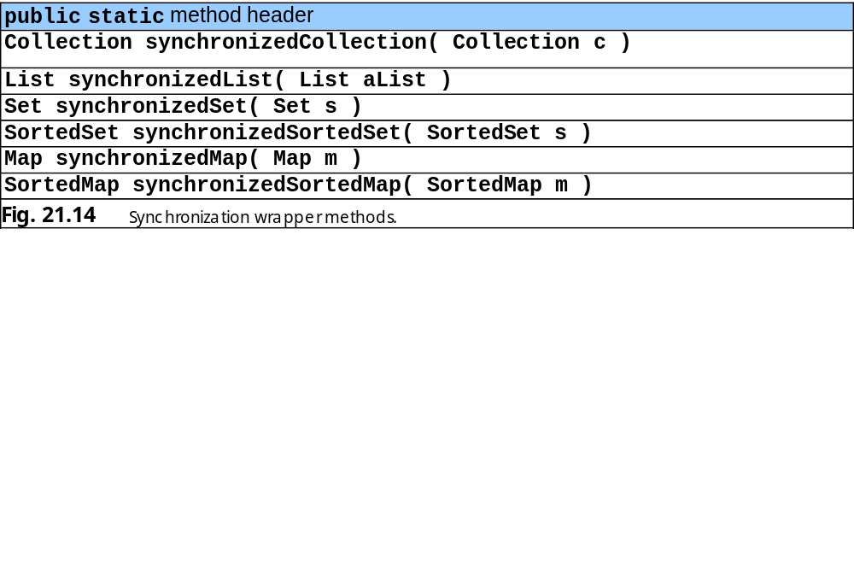
21.9 Synchronization Wrappers (cont.)

Slide 46
21.10 Unmodifiable Wrappers
Unmodifiable wrappers
  Converting collections to unmodifiable collections
  Throw UnsorrtedOperationException if attempts are made to modify the collection

Slide 47
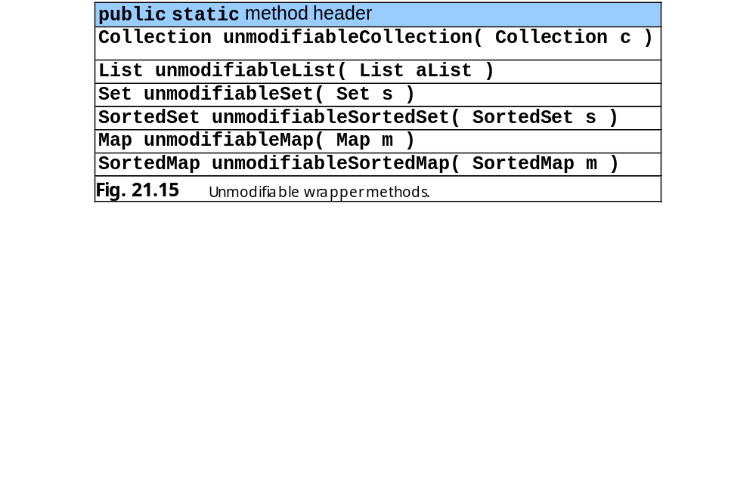
21.10 Unmodifiable Wrappers

Slide 48
21.11 Abstract Implementations
Abstract implementations
  Offer “bare bones” implementation of collection interfaces
    Programmers can “flesh out” customizable implementations
  AbstractCollection
  AbstractList
  AbstractMap
  AbstractSequentialList
  AbstractSet

Slide 49
21.12 (Optional) Discovering Design Patterns: Design Patterns Used in Package java.util
Prototype design pattern
  Creational design pattern
  Used when system must copy an object but cannot determine object type until runtime
  Prototype object returns a copy of itself
    Must belong to a class that implements common interface
      The interface’s implementation provides the copy
      Java API provides:
        Method clone of class java.lang.Object
        Interface java.lang.Cloneable

Slide 50
21.12 (Optional) Discovering Design Patterns: Design Patterns Used in Package java.util (cont.)
Iterator design pattern
  Behavioral design pattern
  Allow objects to access objects from data structure without knowing that data structure’s behavior
    E.g., how the structure stores its objects
    E.g., specifics of traversing the structure
    An object can traverse a linked list and a hash table similarly
  Java provides interface java.util.Iterator

